Slide 1
9 pm EST Tuesday 3 Dec 2024
Assignments
1)Mall
2)Predict Diabetes
LOGISTIC REGRESSION
Recall, Precision, etc

Slide 2
Logistic Regression CONFUSION MATRIX and More Metrics
Arunkumar Nair

Slide 3
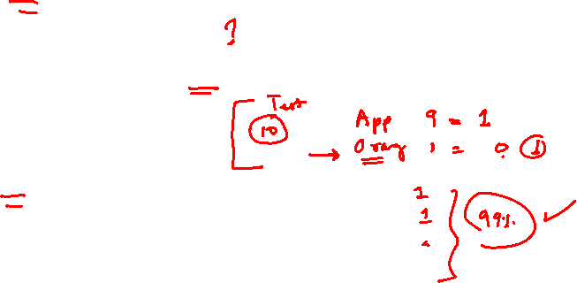
Accuracy and Other Metrics
-When there is a class imbalance, accuracy can be misleading too.
-For Imbalanced Data

Slide 4

Accuracy
-Accuracy is a not a good metric with data class/columns are imbalanced (Not equally split)
When there is a class imbalance, accuracy can be misleading too.
-For Imbalanced Data

Slide 5
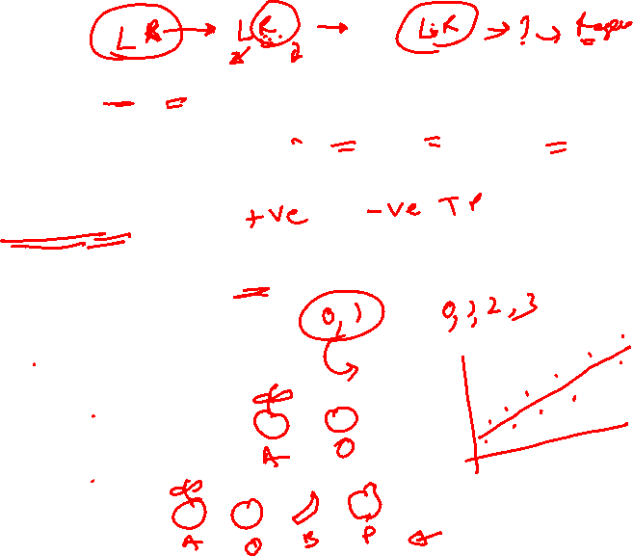
Accuracy and Other Metrics
For a binary classification problem, we will know our positive class (like spam, fraud, has cancer, etc) and hence we can focus on the scores for the positive class.
But, for a multiclass classification problem, apart from the class-wise
recall,
precision,
f1 scores,

Slide 6
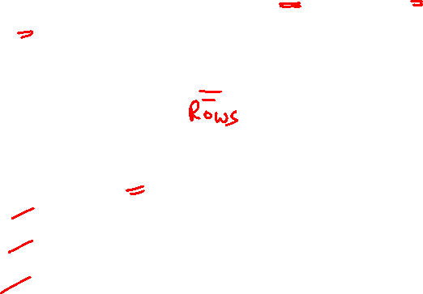

Case-Study Data
As an example, let’s assume that our model predicted the fruit types- Apple (A), Banana(B) and Custard apple(C) and gave the confusion matrix.
Apple (A), Banana(B) and Custard apple(C):
Total number of observations in the data
(i.e., fruits) = 25
A=10
B=8
C=7

Slide 7

Case-Study Data
Apple (A), Banana(B) and Custard apple(C):
Total number of observations in the data (i.e., fruits) = 25
Number of A, B, C type fruits the data has = 10, 8, 7 respectively
Model saw more instances of apples (A = 10) than other fruit types
The diagonal observations are the true positives of each class i.e., the number of times the model correctly identified A as A, B as B and C as C
All other non-diagonal observations are incorrect classifications made by the model
Let’s rebuild the same confusion matrix in python so that the metric values can be validated at each step.

Slide 8
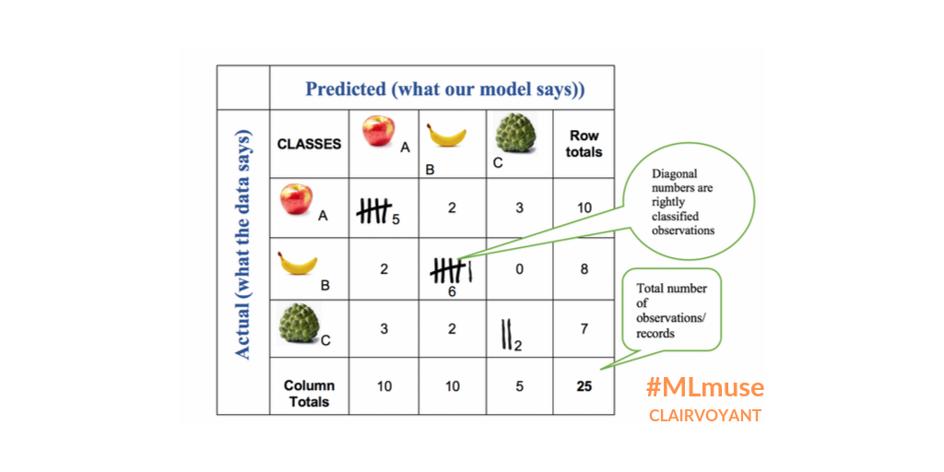
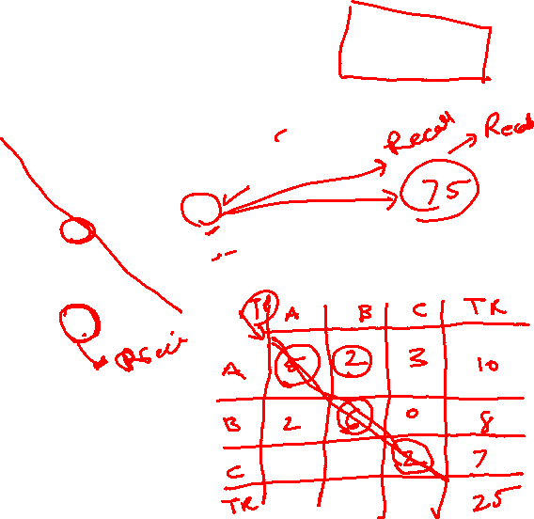
Confusion Matrix
Total number of observations in the data
(i.e., fruits) = 25
A=10
B=8
C=7

Slide 9
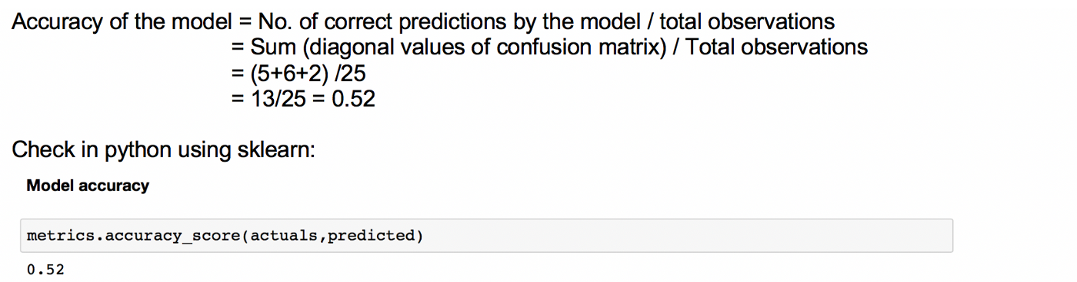
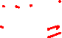
Accuracy:
Tells us how often the model can be correct.

Slide 10
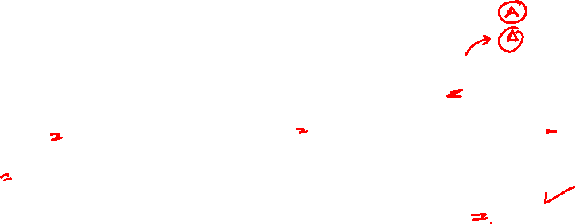
Accuracy is not always Accurate
When there is a class imbalance, accuracy can be misleading too.
Let’s assume that we have a sample of 100 fruits of which 90 are apples and 5 are bananas and 5 are custard apples. Even if our model predicts all the fruits as apples, the accuracy will be 90% while the truth is that our model is not actually doing a great job!

Slide 11
Micro Averages Hence, the need for other metrics:
Accuracy is calculated for the model as a whole but recall and precision are calculated for individual classes.
We use macro or micro or weighted scores of
Recall
Precision
F1 score
of a model for multiclass classification problems.

Slide 12
Micro Averages
In the Micro-average method, you sum up the individual class’s true positives, false positives, and false negatives of the system for different sets and then apply them to get the score.

Slide 13
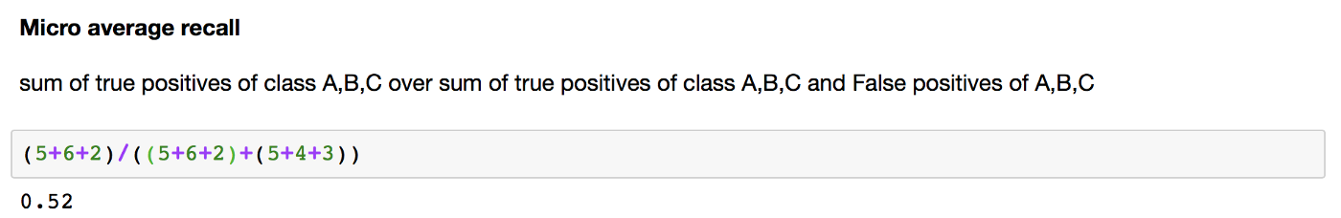
Micro Average Recall Score
For the fruit’s confusion matrix, micro-average recall score is calculated as below (same as in the classification report above):

Slide 14
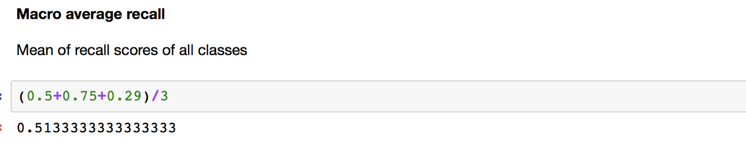
Macro Average Score-Recall

Slide 15
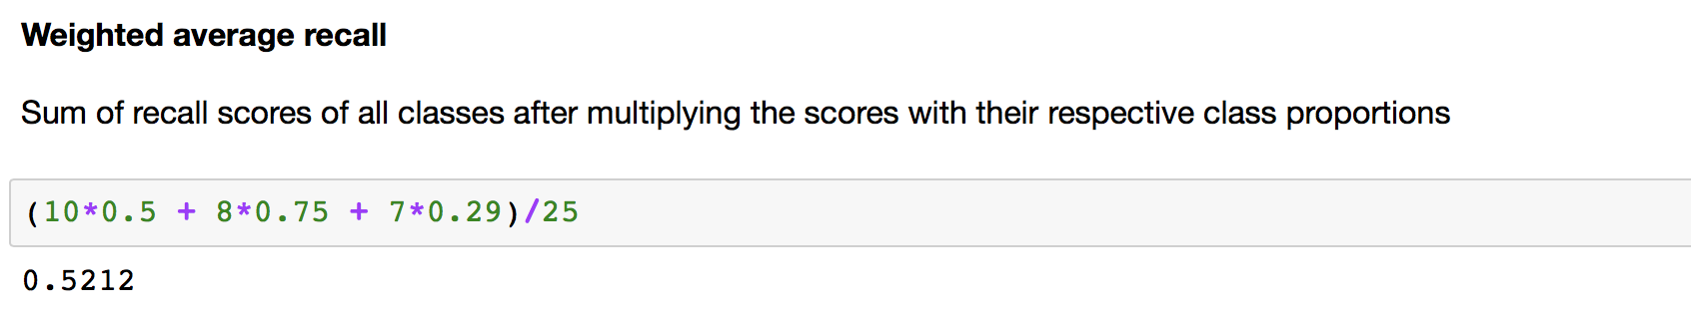
Weighted Average Score-Recall

Slide 16
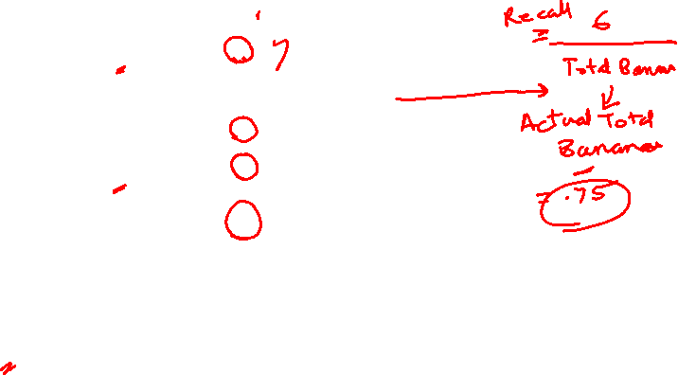
Confusion Matrix
Total number of observations in the data
(i.e., fruits) = 25
A=10
B=8
C=7

Slide 17
Confusion Matrix
Total number of observations in the data
(i.e., fruits) = 25
A=10
B=8
C=7

Slide 18
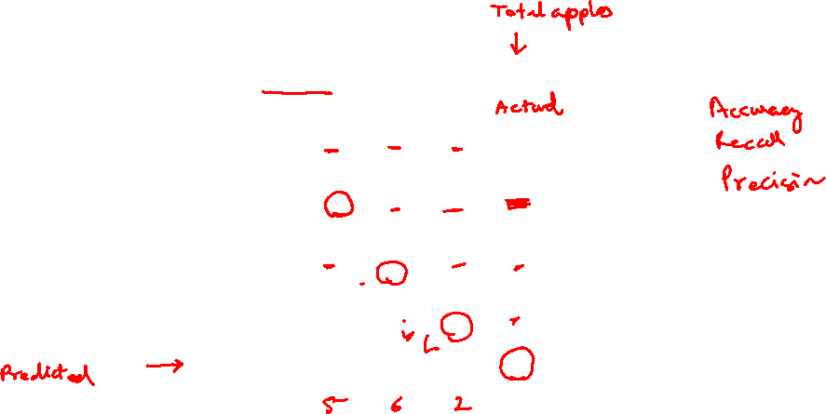
Confusion Matrix
Total number of observations in the data
(i.e., fruits) = 25
A=10
B=8
C=7

Slide 19
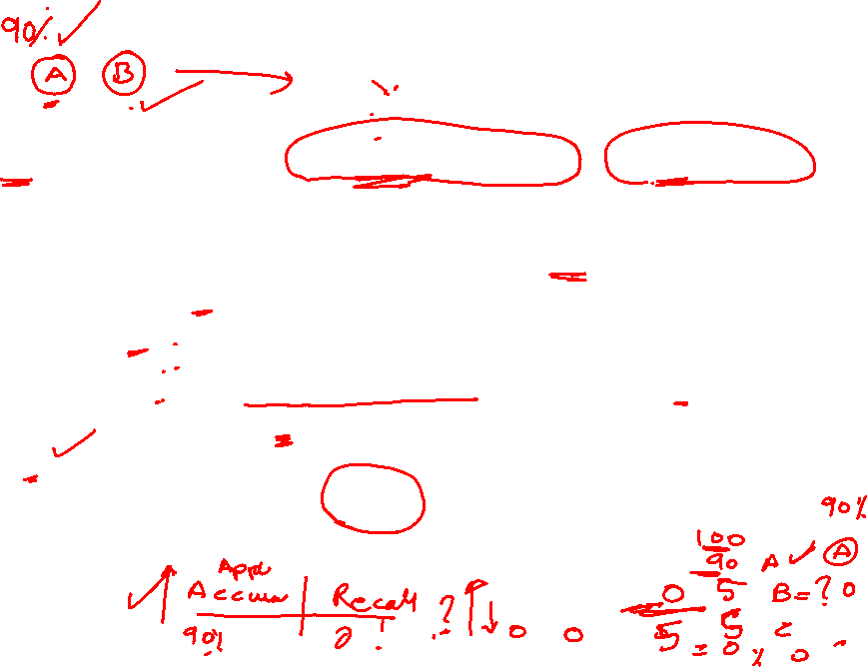
Recall
Recall (also called True Positive Rate or Sensitivity):
As an example, let us calculate recall for class B.
Recall for B would be, from all the actual instances of class B (banana), how often it correctly predicts as B (banana)
Recall for B = out of the total Bs (bananas = 8) in the data, how many Bs did the model identify correctly (6).
So, it would be 6/8 = 0.75 (which is the same as in the classification report above for class B)

Slide 20
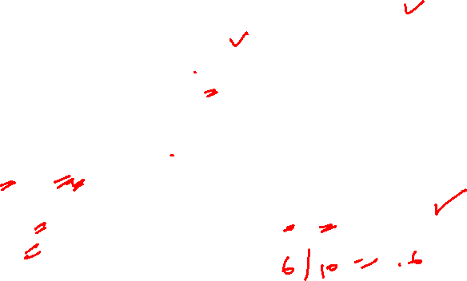
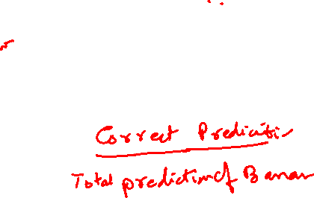
Precision:
Precision for class B is: how often is the model correct when it predicts as B?
As earlier, let’s calculate precision for class B.
Precision for B: out of the total observations predicted as Bs (10) by the model, how many are correct Bs (6). So, it would be 6/10 = 0.6

Slide 21
9 pm EST Wednesday 4 Dec 2024
Classification Report
Recall, Precision, etc
Training was cancelled because of 2 attendess

Slide 22
9 pm EST Thursday 5 Dec 2024
Classification Report
Recall, Precision, etc

Slide 23
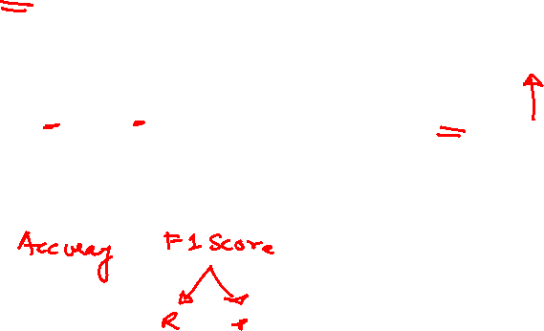
F1-Score
F1 score of class B will be
(2 x Recall x precision)/(Recall + Precision)
=0.75*0.6*2/(0.75+0.6) = 0.67

Slide 24
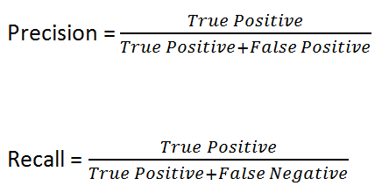
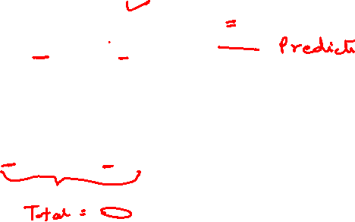
Precision vs Recall

Slide 25
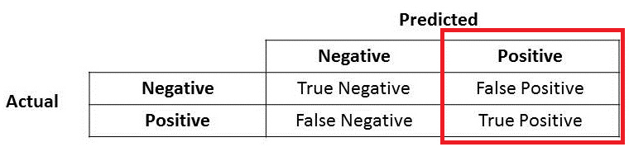
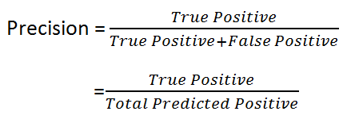

Precision:
True Positive + False Positive = Total Predicted Positive
Precision for class B is: how often is the model correct when it predicts as B?

Slide 26
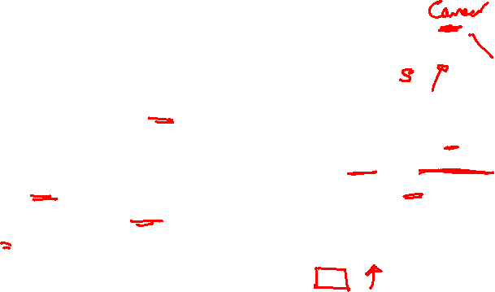
True Positive + False Positive = Total Predicted Positive
Immediately, you can see that Precision talks about how precise/accurate your model is out of those predicted positive, how many of them are actual positive.
Precision is a good measure to determine, when the costs of False Positive is high. For instance, email spam detection. In email spam detection, a false positive means that an email that is non-spam (actual negative) has been identified as spam (predicted spam). The email user might lose important emails if the precision is not high for the spam detection model.

Slide 27
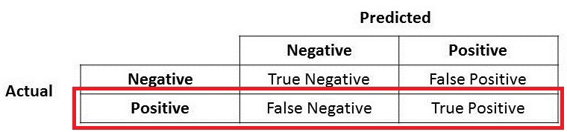
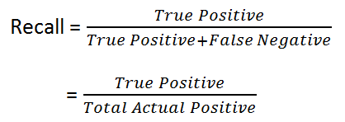
Recall
True Positive + False Negative = Total Actual Positive

Slide 28
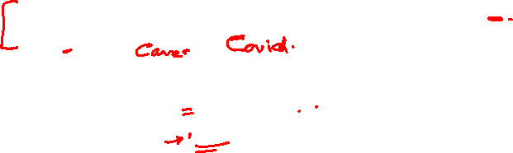
True Positive + False Negative = Total Actual Positive
So Recall actually calculates how many of the Actual Positives our model capture through labeling it as Positive (True Positive). Applying the same understanding, we know that Recall shall be the model metric we use to select our best model when there is a high cost associated with False Negative.
For instance, in fraud detection or sick patient detection. If a fraudulent transaction (Actual Positive) is predicted as non-fraudulent (Predicted Negative), the consequence can be very bad for the bank.
Similarly, in sick patient detection. If a sick patient (Actual Positive) goes through the test and predicted as not sick (Predicted Negative). The cost associated with False Negative will be extremely high if the sickness is contagious.

Slide 29
True Positive + False Positive = Total Predicted Positive
Immediately, you can see that Precision talks about how precise/accurate your model is out of those predicted positive, how many of them are actual positive.
Precision is a good measure to determine, when the costs of False Positive is high. For instance, email spam detection. In email spam detection, a false positive means that an email that is non-spam (actual negative) has been identified as spam (predicted spam). The email user might lose important emails if the precision is not high for the spam detection model.

Slide 30

F1-Score
F1 Score is needed when you want to seek a balance between Precision and Recall. Right…so what is the difference between F1 Score and Accuracy then?

Slide 31
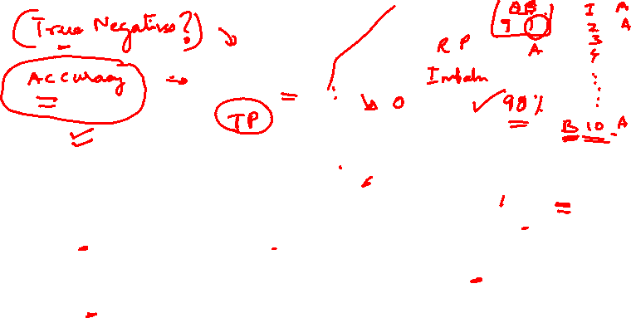
F1-Score
We have previously seen that accuracy can be largely contributed by a large number of True Negatives which in most business circumstances, we do not focus on much whereas False Negative and False Positive usually has business costs (tangible & intangible) thus F1 Score might be a better measure to use if we need to seek a balance between Precision and Recall AND there is an uneven class distribution (large number of Actual Negatives).

Slide 32
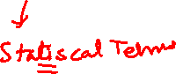
Specificity, Sensitivity

Slide 33
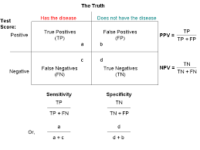
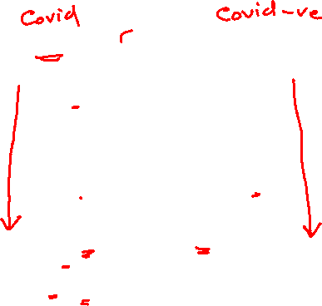

Slide 34
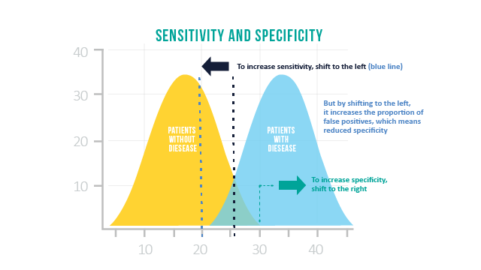
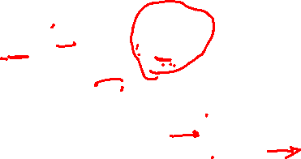

Slide 35
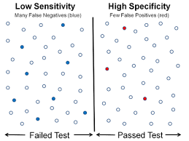
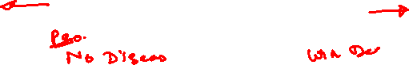

Slide 36
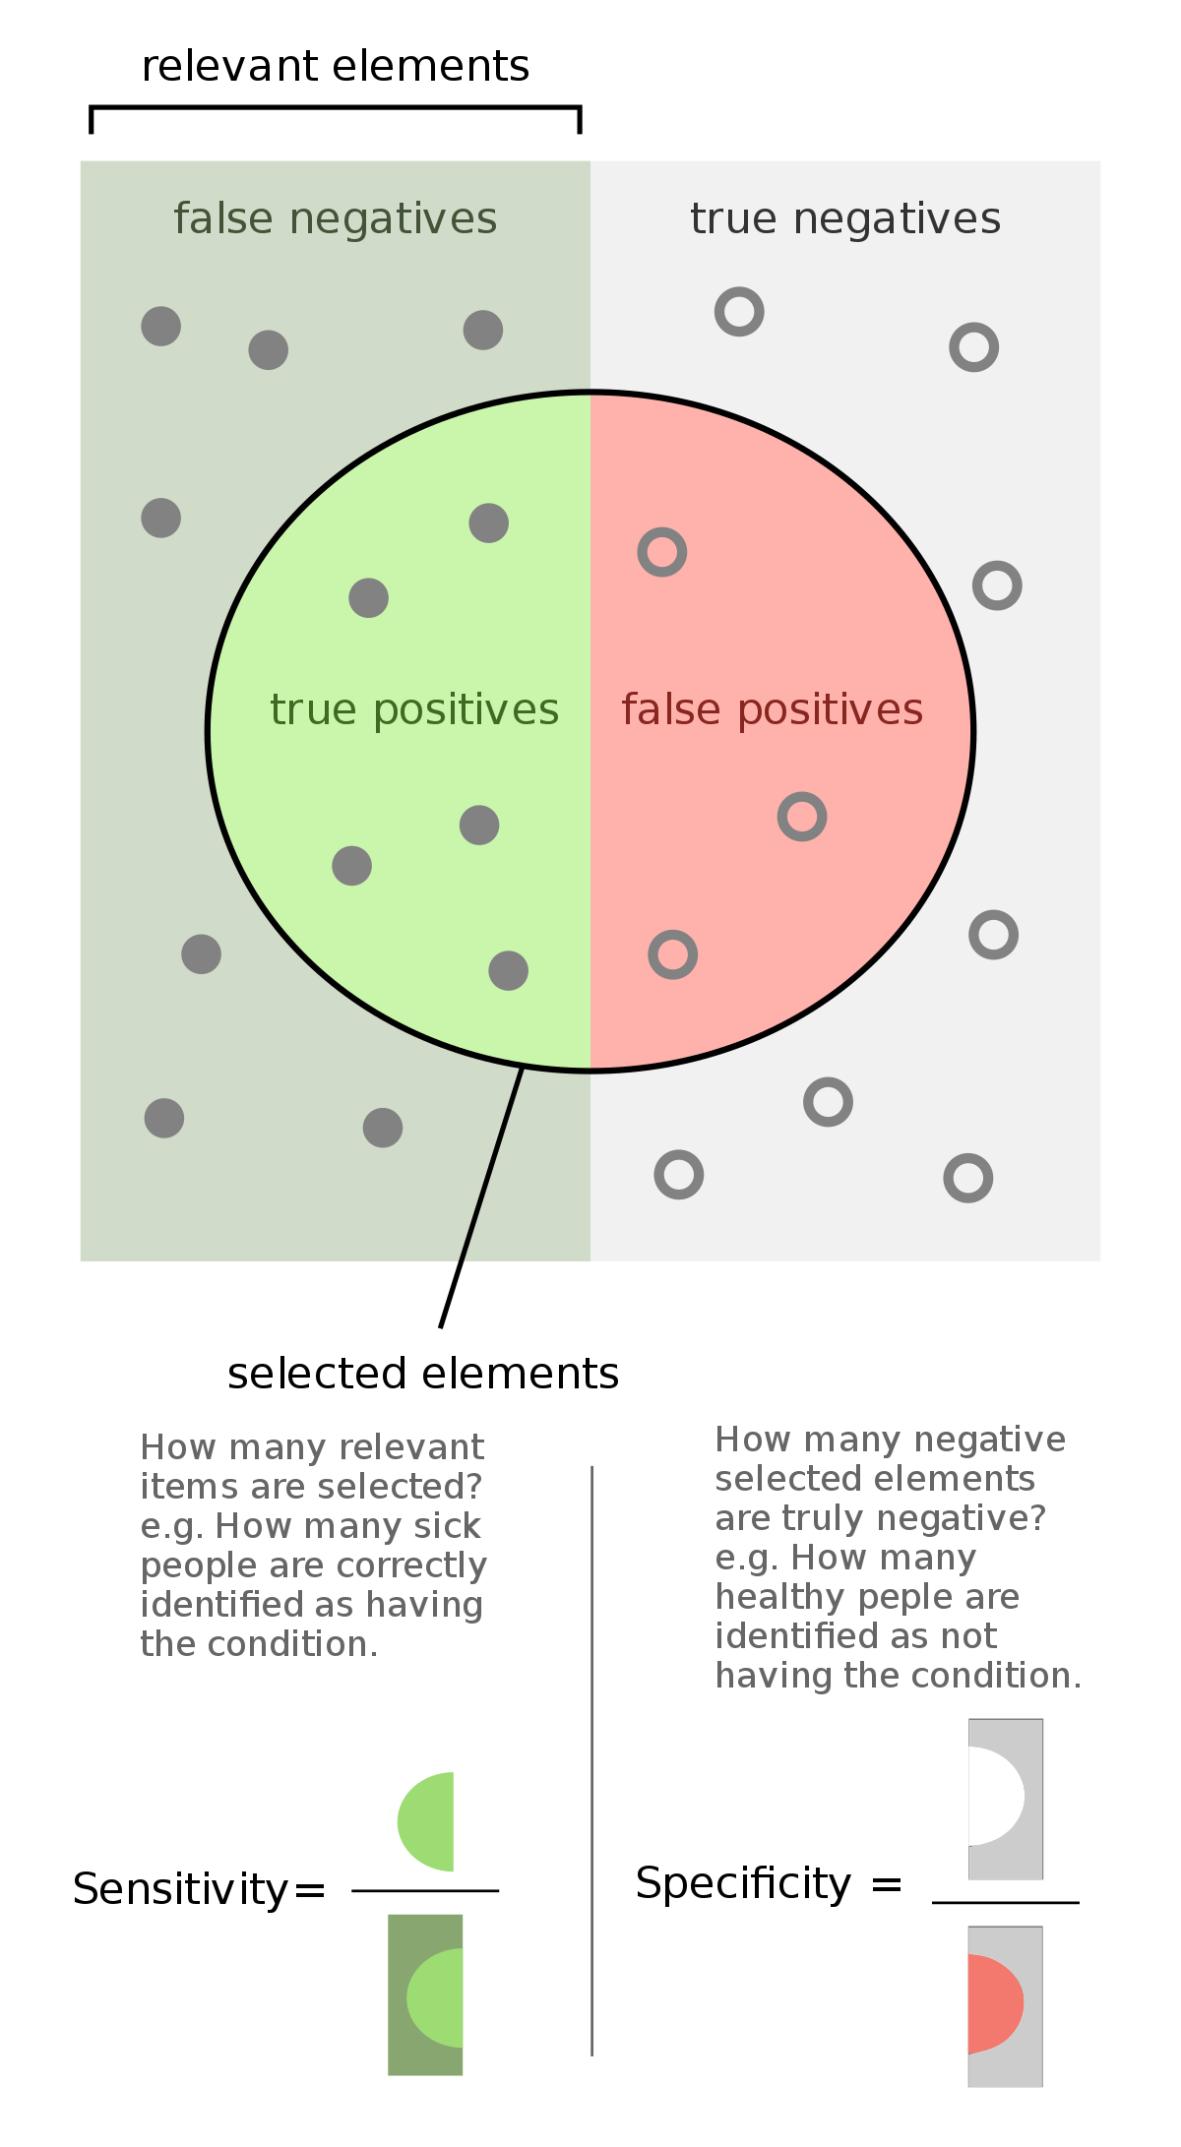
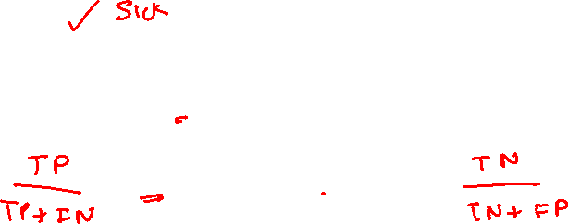

Slide 37
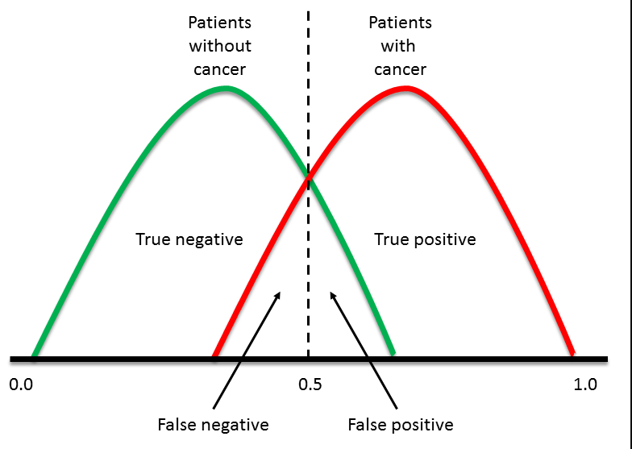
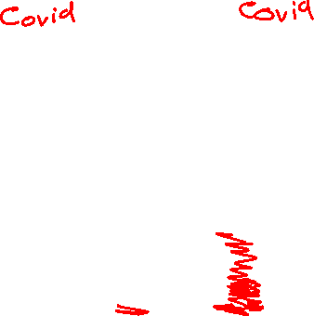

Slide 38
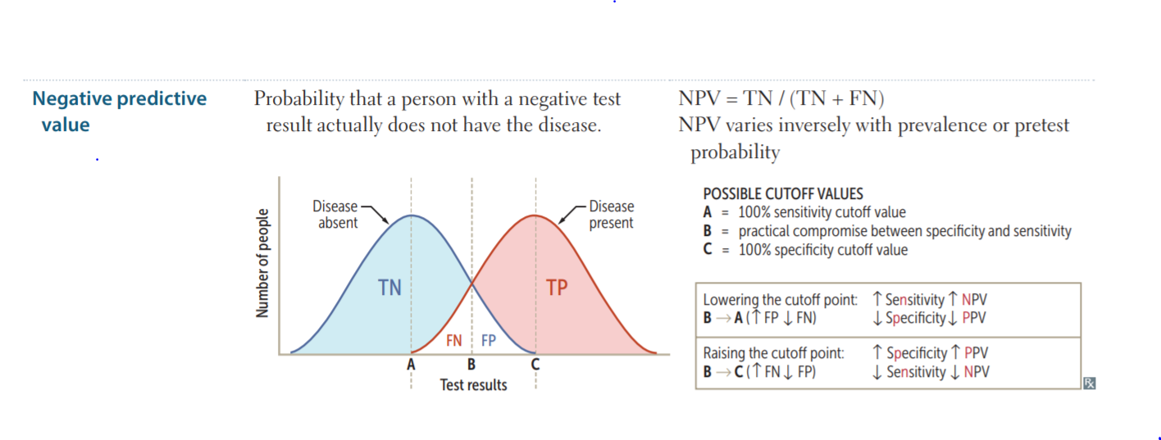
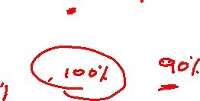

Slide 39
ROC CURVES

Slide 40
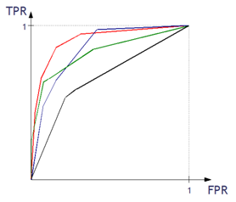
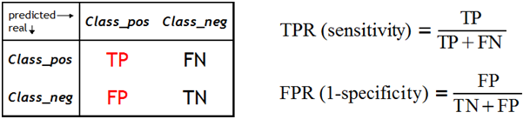
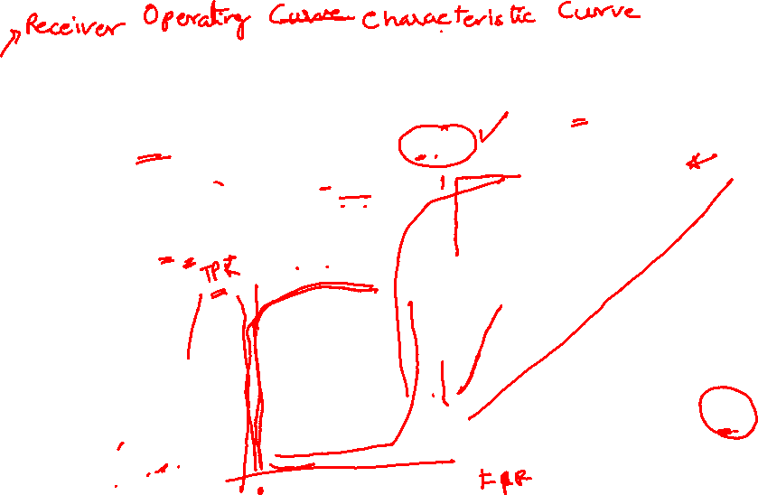
What is the ROC curve?
The ROC curve is one of the methods for visualizing classification quality, which shows the dependency between TPR (True Positive Rate) and FPR (False Positive Rate).
Notes:
http://algolytics.com/how-to-assess-quality-and-correctness-of-classification-models-part-4-roc-curve/
The more convex the curve, the better the classifier. In the example below, the “green” classifier is better in area 1, and the “red” classifier is better in area 2

Slide 41
How is the ROC curve created
We compute the values of the decision function.
We test the classifier for different alpha thresholds. Recall that alpha is the threshold of the estimated probability, above which an observation is assigned to one category (positive class) and below to the other category (negative class).
For each classification with one value of the alpha threshold we obtain a (TPR, FPR) pair, which corresponds to one point on the ROC curve.
For each classification with one value of the alpha threshold we also have the corresponding Confusion Matrix.
Notes:
http://algolytics.com/how-to-assess-quality-and-correctness-of-classification-models-part-4-roc-curve/
The more convex the curve, the better the classifier. In the example below, the “green” classifier is better in area 1, and the “red” classifier is better in area 2

Slide 42
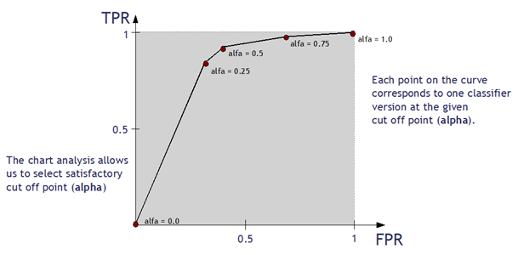
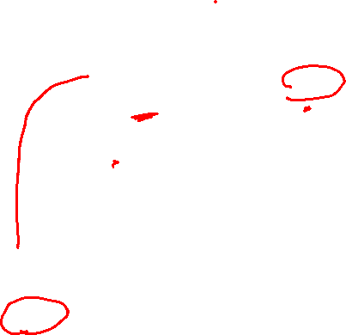
How is the ROC curve created
We compute the values of the decision function.
Notes:
http://algolytics.com/how-to-assess-quality-and-correctness-of-classification-models-part-4-roc-curve/
The more convex the curve, the better the classifier. In the example below, the “green” classifier is better in area 1, and the “red” classifier is better in area 2

Slide 43
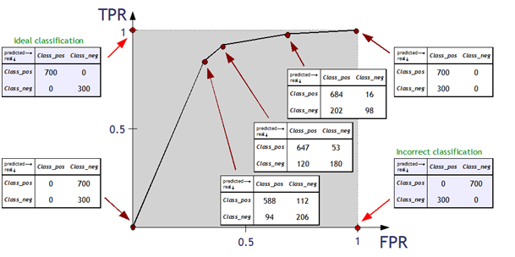
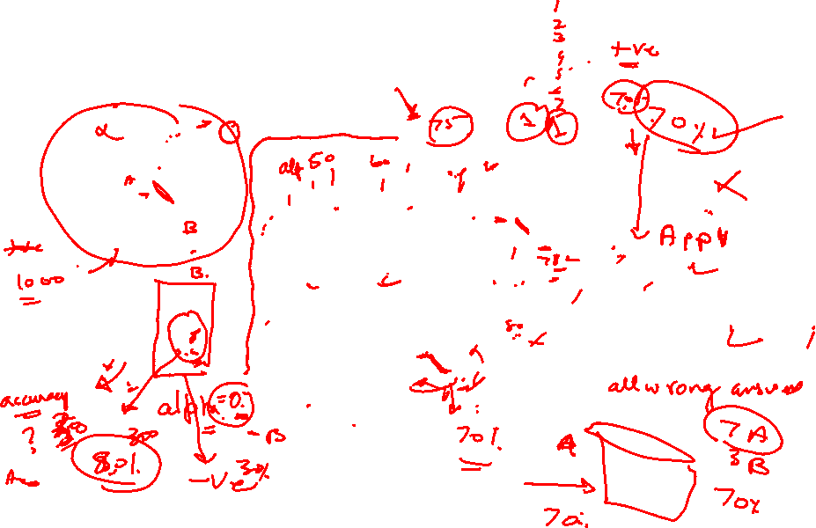
How is the ROC curve created
We compute the values of the decision function.
Notes:
http://algolytics.com/how-to-assess-quality-and-correctness-of-classification-models-part-4-roc-curve/
The more convex the curve, the better the classifier. In the example below, the “green” classifier is better in area 1, and the “red” classifier is better in area 2

Slide 44
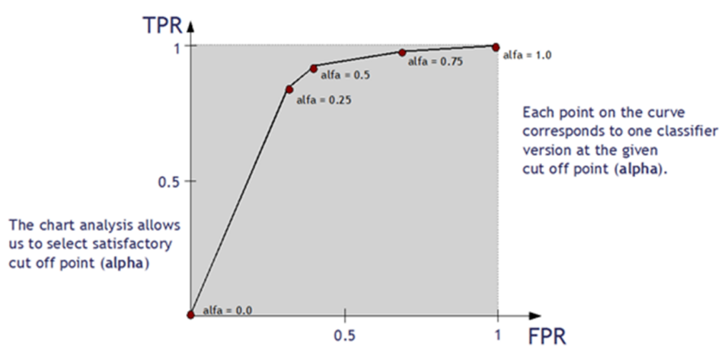
How is the ROC curve created
We compute the values of the decision function.
Notes:
http://algolytics.com/how-to-assess-quality-and-correctness-of-classification-models-part-4-roc-curve/
The more convex the curve, the better the classifier. In the example below, the “green” classifier is better in area 1, and the “red” classifier is better in area 2

Slide 45
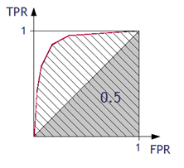
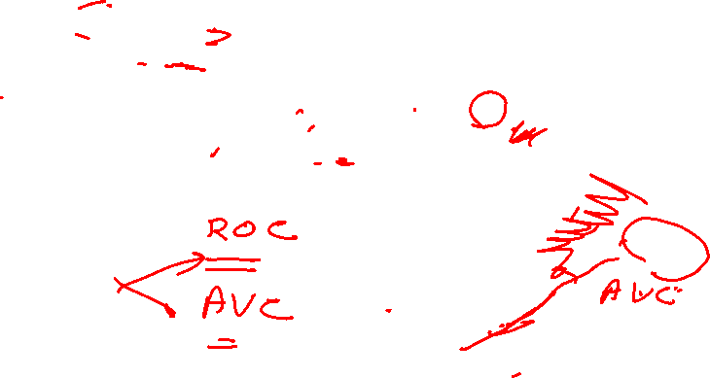
Assessing the classifier using ROC curve
Area under ROC Curve (AUC) coefficient
The higher the value of AUC coefficient, the better. AUC = 1 means a perfect classifier, AUC = 0.5 is obtained for purely random classifiers. AUC < 0.5 means the classifier performs worse than a random one.
Notes:
http://algolytics.com/how-to-assess-quality-and-correctness-of-classification-models-part-4-roc-curve/
The more convex the curve, the better the classifier. In the example below, the “green” classifier is better in area 1, and the “red” classifier is better in area 2
https://acutecaretesting.org/en/articles/roc-curves-what-are-they-and-how-are-they-used

Slide 46
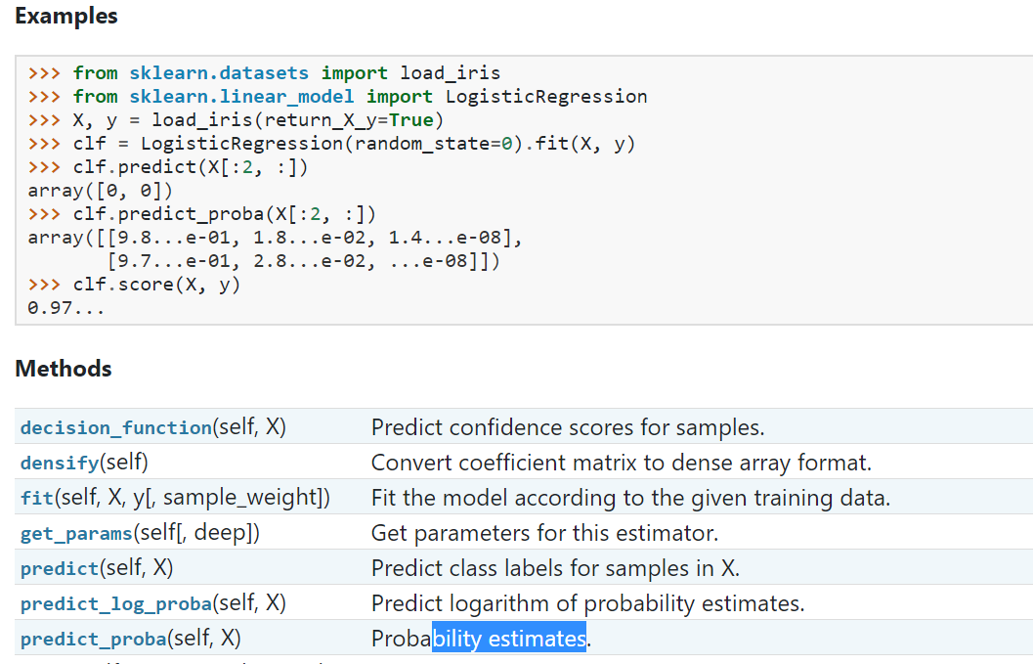

Slide 47


Slide 48
precision-recall-or-specificity-sensitivity
Notes:
https://medium.com/@alon.lek/should-i-look-at-precision-recall-or-specificity-sensitivity-3946158aace1

Slide 49
precision-recall-or-specificity-sensitivity
Machine Learning : precision and recall to evaluate the models
Medical Industry: specificity and sensitivity to evaluate medical tests.

Slide 50


Slide 51


Slide 52



Precision — Out of all the examples that predicted as positive, how many are really positive?
positive predictive value
Recall — Out of all the positive examples, how many are predicted as positive?
Specificity — Out of all the people that do not have the disease, how many got negative results?
Recall and Sensitivity are the same.

Slide 53
Precision — Out of all the examples that predicted as positive, how many are really positive?

Slide 54
Recall — Out of all the positive examples, how many are predicted as positive?
Recall and Sensitivity are the same.
Sensitivity — Out of all the people that have the disease, how many got positive test results?

Slide 55
Specificity — Out of all the people that do not have the disease, how many got negative results?

Slide 56

Sensitivity — Out of all the people that have the disease, how many got positive test results?
Recall and Sensitivity are the same.

Slide 57
Classification Problems
If we define a positive example as “person that has a disease” we can see that
Recall and Sensitivity are the same(Consider Sensitivity as Recall)
but Precision and Specificity are different. Precision is also called PPV (Positive Predictive Value).

Slide 58
Classification Problems
8 different classification problems and classifiers. Each classifier tries to classify 10 samples to positive and negative “baskets” in a way that maximizes or minimizes each one of the measures.

Slide 59

Example 1 — Low Precision, High Recall, and High Specificity
10 example
1
FP
9
TP
positive example as “person that has a disease”
FN
TN
7 Negative
3 Positive
0 F Negative
7 T Negative
2 F Positive
1 T Positive
If the classifier predicts negative, you can trust it, the example is negative. However, pay attention, if the example is negative, you can’t be sure it will predict it as negative (specificity=78%).
If the classifier predicts positive, you can’t trust it (precision=33%). However, if the example is positive, you can trust the classifier (recall=100%).
Notes:
If we define a positive example as “person that has a disease” we can see that Recall and Sensitivity are the same,

Slide 60

Example 2 — High Precision, High Recall, and Low Specificity
10 example
1
FP
9
TP
positive example as “person that has a disease”
FN
TN
0 Negative
10 Positive
0 F Negative
0 T Negative
1 F Positive
9 T Positive
Predicting everything as positive clearly can’t be a good idea. However, because the population is imbalanced the precision is relatively high, the recall is 100% because all the positive examples are predicted as positive. But the specificity is 0% because no negative example is predicted as negative.
Notes:
If we define a positive example as “person that has a disease” we can see that Recall and Sensitivity are the same,

Slide 61

Example 3 — High Precision, Low Recall, and High Specificity
10 example
9
FP
1
TP
positive example as “person that has a disease”
FN
TN
9 Negative
1 Positive
8 F Negative
1 T Negative
0 F Positive
1 T Positive
This can be a useful classifier — If it predicts that an example is positive, you can trust it — it is positive. However, if it predicts it is negative, you can’t trust it, the chances are that it is still positive.
Notes:
If we define a positive example as “person that has a disease” we can see that Recall and Sensitivity are the same,

Slide 62

Example 4 — Low Precision, Low Recall, and High Specificity
10 example
1
FP
9
TP
positive example as “person that has a disease”
FN
TN
9 Negative
1 Positive
1 F Negative
8 T Negative
1 F Positive
0 T Positive
This classifier is really bad — It almost predicts all as negative, and when the prediction is positive — it is wrong. Actually using the opposite of what this classifier predicts is better.
Notes:
If we define a positive example as “person that has a disease” we can see that Recall and Sensitivity are the same,

Slide 63

Example 5 — High Precision, Low Recall, and Low Specificity
10 example
9
FP
1
TP
positive example as “person that has a disease”
FN
TN
7 Negative
3 Positive
7 F Negative
0 T Negative
1 F Positive
2 T Positive
Doing the opposite of what this classifier predicts should work better here.
Notes:
If we define a positive example as “person that has a disease” we can see that Recall and Sensitivity are the same,

Slide 64

Example 6 — Low Precision, High Recall, and Low Specificity
10 example
1
FP
9
TP
positive example as “person that has a disease”
FN
TN
0 Negative
10 Positive
0 F Negative
0 T Negative
9 F Positive
1 T Positive
This classifier is probably useless — it predicts everything as positive. So, it can detect perfectly all the positive examples, of course (high recall), but you can’t get any information from using it.
Notes:
If we define a positive example as “person that has a disease” we can see that Recall and Sensitivity are the same,

Slide 65

Example 7 — High Precision, High Recall, and High Specificity
10 example
9
FP
1
TP
positive example as “person that has a disease”
FN
TN
1 Negative
9 Positive
0 F Negative
1 T Negative
0 F Positive
9 T Positive
This is the “Holy Grail” — The classifier detects all the positive examples as positive and negative examples as negative. All the measures are at 100%.
Notes:
If we define a positive example as “person that has a disease” we can see that Recall and Sensitivity are the same,

Slide 66

Example 8 — Low Precision, Low Recall, and Low Specificity
10 example
1
FP
9
TP
positive example as “person that has a disease”
FN
TN
1 Negative
9 Positive
1 F Negative
0 T Negative
9 F Positive
0 T Positive
This looks like a bad classifier, all the positive examples are predicted as negative and all the negative as positive. All the measures are 0%. However, you can simply do the opposite of what it predicts and then it is perfect
Notes:
If we define a positive example as “person that has a disease” we can see that Recall and Sensitivity are the same,

Slide 67
In conclusion, all the measures (precision, recall, and specificity) give us important information about how well is our classification model. It is important to look at all of them. For example, without looking at specificity you could create a model with great precision and recall that simply predicts everything as true, and has no real value (like in example 2 above).

Slide 68
Suppose a computer program for recognizing dogs in photographs identifies 8 dogs in a picture containing 12 dogs and some cats. Of the 8 identified as dogs, 5 actually are dogs (true positives), while the rest are cats (false positives). The program's precision is 5/8 while its recall is 5/12.

Slide 69
The above pattern recognition example contained 8 − 5 = 3 type I errors and 12 − 5 = 7 type II errors. Precision can be seen as a measure of exactness or quality, whereas recall is a measure of completeness or quantity. The exact relationship between sensitivity and specificity to precision depends on the percent of positive cases in the population.
In simple terms, high precision means that an algorithm returned substantially more relevant results than irrelevant ones, while high recall means that an algorithm returned most of the relevant results.

Slide 71
9 pm EST Friday 6 Dec 2024
Recall our learnings

Slide 72



Slide 73


Slide 74


Slide 75


Slide 76


Slide 77


Slide 78



Slide 79


Slide 80


Slide 81



Slide 82



Slide 83


Slide 84


Slide 86
9 pm EST Monday 10 Dec 2024
Quiz
Interview Questions

Slide 88



Slide 89


Slide 90


Slide 91


Slide 92


Slide 93


Slide 94


Slide 96

9 pm EST Tuesday 10 Dec 2024
Quiz
Bias Variance

Slide 97


Slide 99



Slide 100



Slide 101



Slide 102


Slide 103

Thanks
End

